Slide 1

Design Patterns
Part 1
Lucky Nkosi

Slide 2
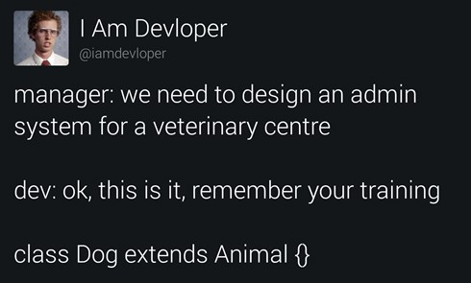
Content:
Design Patterns Introduction
Types of Design Pattern
Anti-Patterns
Creational Design Patterns
Factory
Prototype
Abstract Factory
Builder
Singleton
Design Pattern Pitfalls

Slide 3
What is a pattern?
A pattern is a recurring theme, design, or arrangement that can be observed in various contexts. It's essentially a regularity that can be identified within data, behavior, structures, or events.

Slide 4

Design Patterns
A design pattern is a general, reusable solution to a commonly occurring software design problem
A design pattern is not a ready-made code package
Rather, it is a template that a developer can modify and implement for their particular applications

Slide 5

Design Patterns
Concerned With:
Application & System Design
Abstractions on top of code
Relationships between classes & other collaborators
Problems that have already been solved
NOT concerned with:
Algorithms
Specific implementations or classes

Slide 6

Design Patterns
Design patterns are different from architecture styles:
Architecture styles focus on components and how they relate to each other
Design patterns focus on low-level code, objects and classes
If someone says “X” is a design pattern, expect code, class diagrams, etc,
If someone says “Y” is an architecture style, expect higher level diagrams (component diagrams, activity diagrams, etc.)
The line between architecture and design is blurry

Slide 7
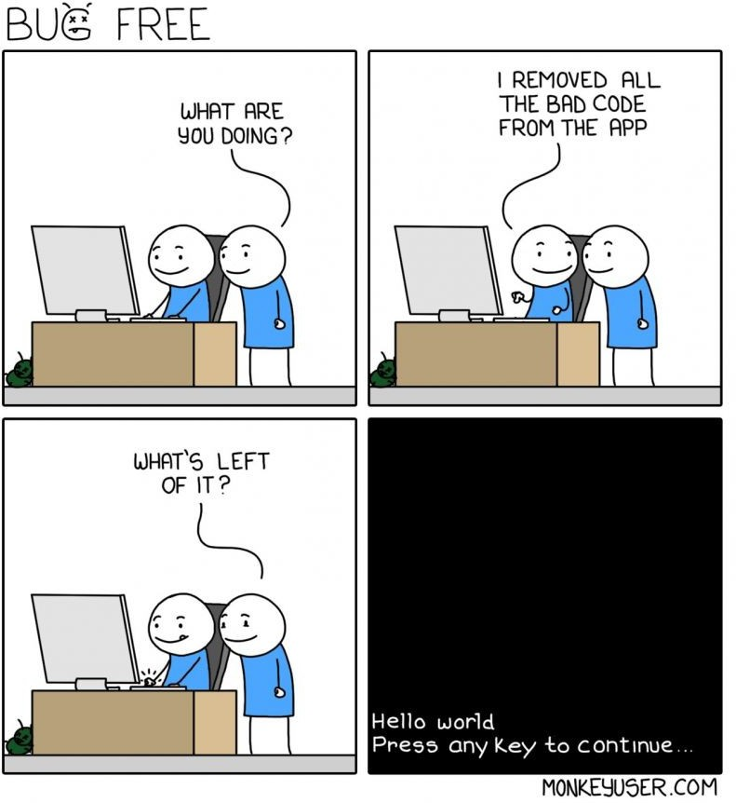
Anti-Patterns
An anti-pattern is a design pattern that is ineffective and counterproductive
Anti-patterns represent common pitfalls in software design

Slide 8
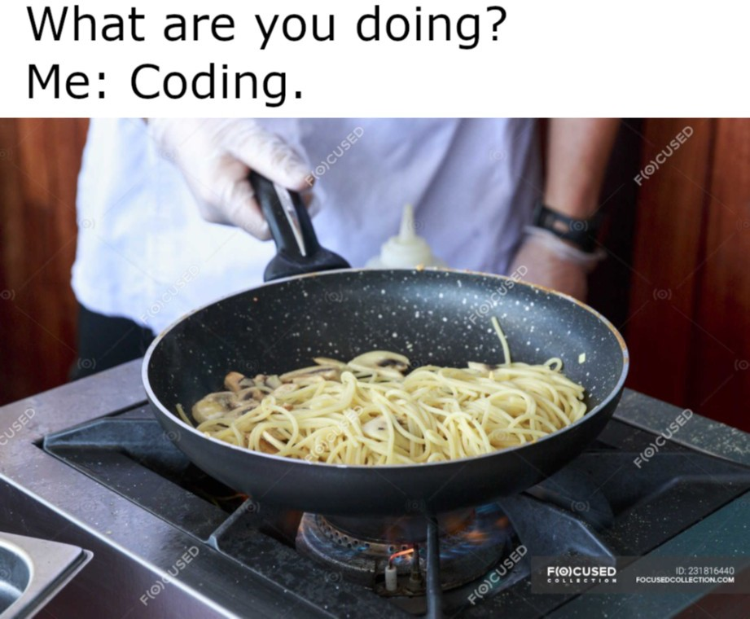
Anti-Patterns
●
Spaghetti Code - ad hoc software structure makes it difficult to extend and optimize code
●
a.k.a. Big Ball of Mud
●
Lava Flow – unready code is put into production and is added to while still in an unfinished state
Golden Hammer – obsessively applying a familiar tool to every software problem
●
●
“If all you have is a hammer, everything looks like a nail”
●
Boat Anchor – code that doesn’t do anything is left in the codebase “just in case”
God Class – one class taking on too many responsibilities
Poltergeist Class - useless classes with no real responsibility of their own, often used to just invoke methods in another class or add an unneeded layer of abstraction.
●
●

Slide 9

What do Software Developers do?
Develop software of course!
Code
Design (requirements engineering, architecture, etc.)
But a developer’s work is never done
Understand existing software
Maintain software (fix bugs)
Upgrade (add new features)
In other words, software is constantly changing

Slide 10
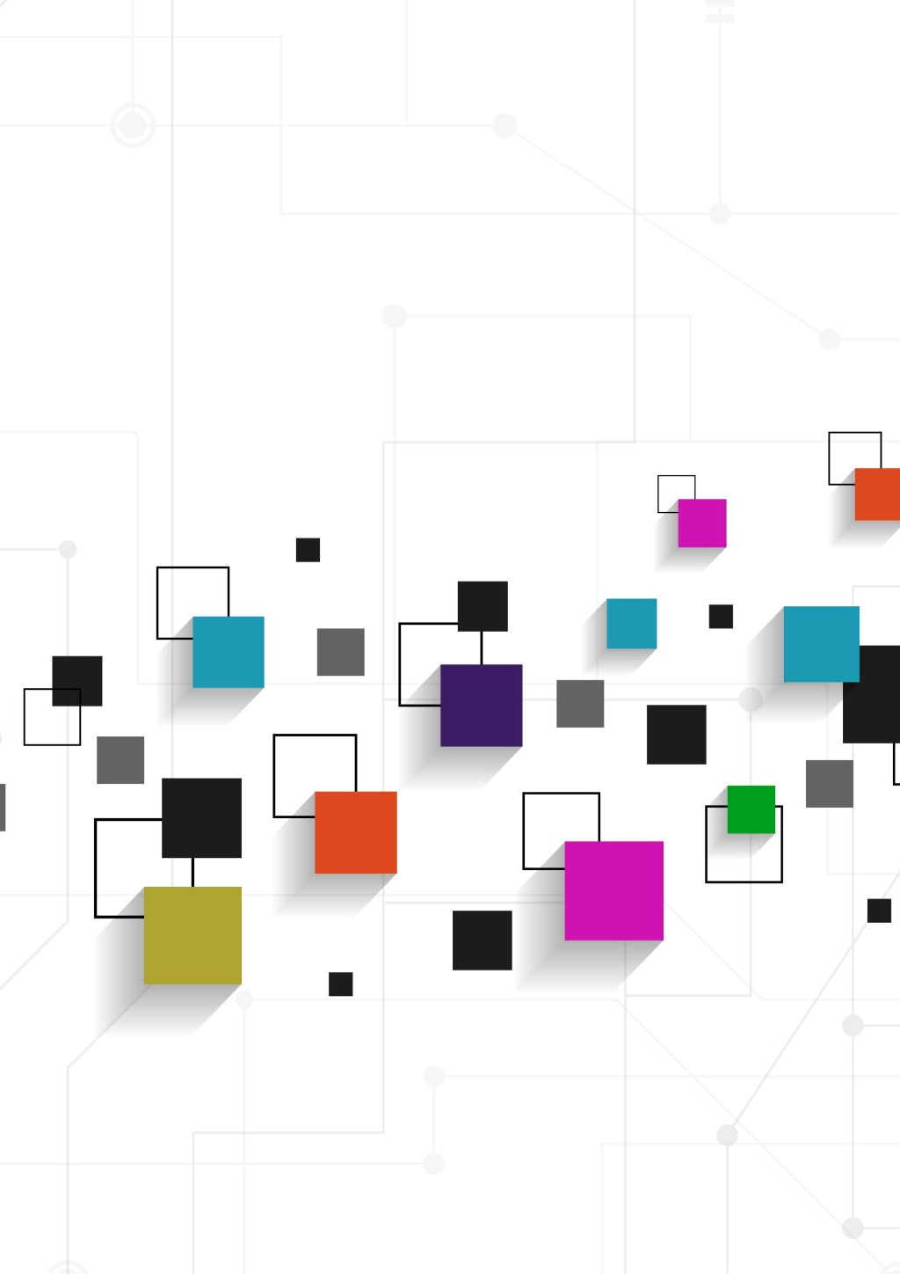
Why Design Patterns?
Design patterns help anticipate change
Change is needed to keep up with reality
Change may have bad consequences when there are unrelated reasons to change a software module/class
Design patterns can also target complex conditional logic
Design patterns provide a common language to communicate solutions with other developers
Notes:
Change may be triggered by changing business environment or by deciding to refactor classes that are deemed potentially problematic

Slide 11
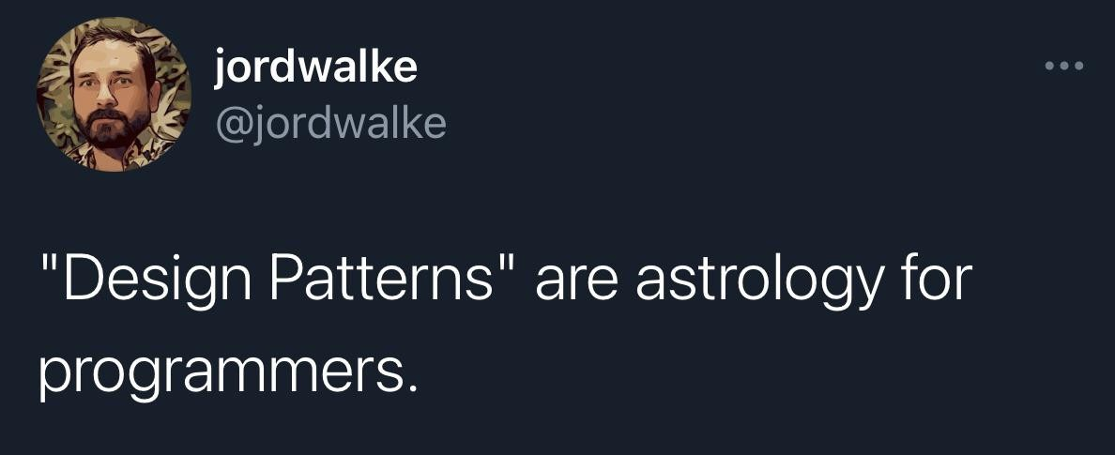
Other Considerations
When is a design pattern needed/applicable?
How can we tell if a pattern is making things better or worse?
When should we avoid patterns that will make things worse?

Slide 12
References
●
Design Patterns: Elements of Reusable Object-Oriented Software
Written in 1994, it is a very influential text in software design
Written by Erich Gamma, Richard Helm, Ralph Johnson, and John Vlissides
●
●
●
The so-called “Gang of Four” (GoF)
●
Online version
●
Refactoring Guru – Design Patterns

Slide 13

SOLID Principles

Slide 14

SOLID Principles
Introduced by Robert C. Martin in his 2000 paper “Design Principles and Design Patterns” to help developers write software that is easy to understand, modify, and extend.
The SOLID principles are a set of guidelines for writing high-quality, maintainable, and scalable software.

Slide 15
SOLID
Single Responsibility Principle (SRP)
Open-Closed Principle (OCP)
Liskov Substitution Principle (LSP)
Interface Segregation Principle (ISP)
Dependency Inversion Principle (DIP)

Slide 16
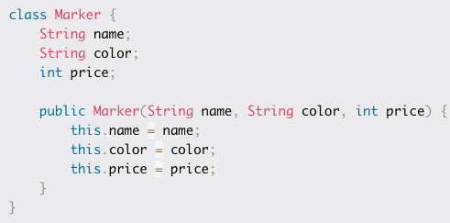
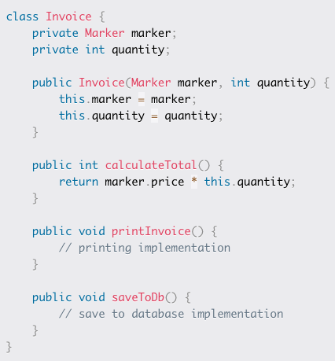
SRP
The Single Responsibility Principle (SRP) states that a class should have only one reason to change, or in other words, it should have only one responsibility. This means that a class should have only one job to do, and it should do it well.
Too many responsibilities lead to code that is:
Difficult to understand
Difficult to maintain
Difficult to maintain
Notes:
Diificult because changes to one responsibility could potentially lead to a lot more thing breaking. It requires much more regression testing
Marker has 1 responsibility and invoice has many

Slide 17

Open-Closed Principle (OCP)
The Open-Closed Principle (OCP) states that software entities (classes, modules, functions, and so on) should be open for extension but closed for modification. This means that the behaviour of a software entity can be extended without modifying its source code.
OCP Promotes software extensibility and maintainability
Developers can add new functionality without the risk of breaking existing code.
Results in code that is easier to maintain, extend, and reuse.

Slide 18
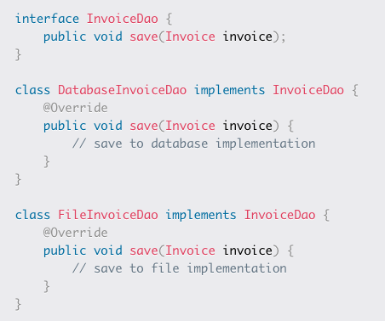
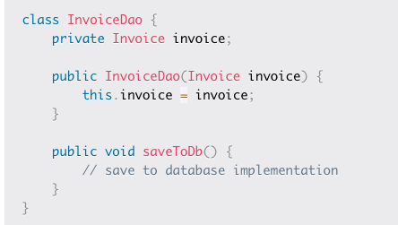
Open-Closed Principle (OCP)
Notes:
InvoiceDao saves invoice to DB. We deploy and productionise it then get a new requirement to save to file. This would require a change to this class and that breaks the OCP
Instead, the correct approach from get go would be to have an interface that each save functionality can implement. Allow you to exten the functionality as much as necessary.

Slide 19
Liskov Substitution Principle
The Liskov Substitution Principle (LSP) states that any instance of a derived class should be substitutable for an instance of its base class without affecting the correctness of the program.
In other words, a derived class should behave like its base class in all contexts. In more simple terms, if class A is a subtype of class B, you should be able to replace B with A without breaking the behaviour of your program
Violating the LSP can lead to unexpected behavior, bugs, and maintainability issues.

Slide 20
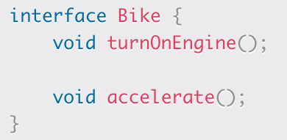
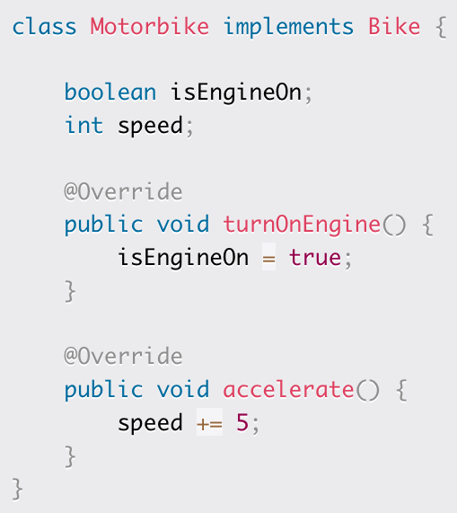
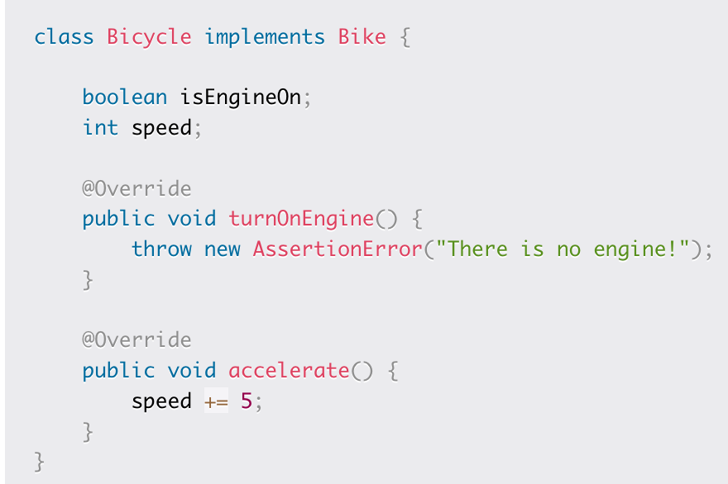
Liskov Substitution Principle
Notes:
Bicycle throws an AssertionError while trying to turn on the engine. Therefore, the code violates the LSP because they can’t be substitued
However, the Bicycle class throws an AssertionError in the turnOnEngine() method because it has no engine. This means that an instance of Bicycle cannot be substituted for an instance of Bike without breaking the behavior of the program.
In other words, if the Bicycle class is considered a subtype of the Bike interface, then according to the LSP, any instance of Bike should be replaceable with an instance of Bicycle without altering the correctness of the program.
But in this case, it's not true because Bicycle throws an AssertionError while trying to turn on the engine. Therefore, the code violates the LSP.

Slide 21
Interface Segregation Principle (ISP)
The Interface Segregation Principle (ISP) focuses on designing interfaces that are specific to their client's needs. It states that no client should be forced to depend on methods it does not use.
The principle suggests that instead of creating a large interface that covers all the possible methods, it's better to create smaller, more focused interfaces for specific use cases. This approach results in interfaces that are more cohesive and less coupled.

Slide 22
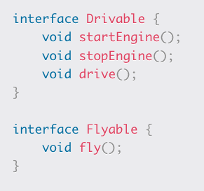
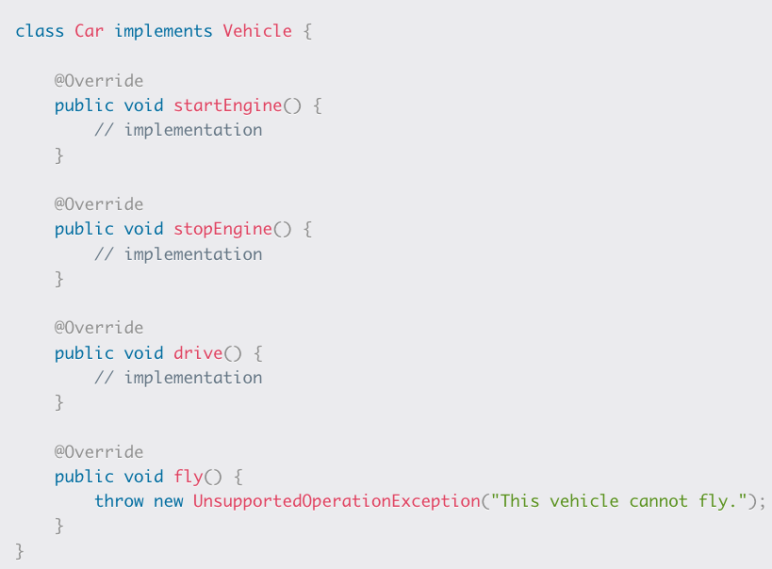
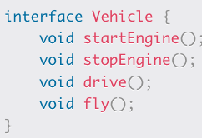
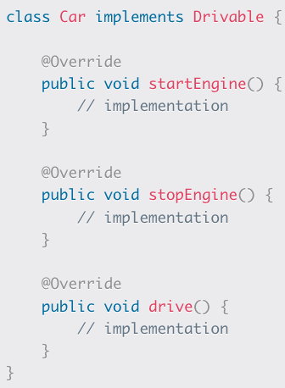
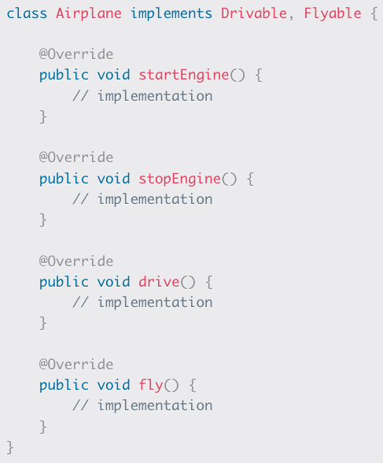
Interface Segregation Principle (ISP)
Interface is clearly too broad
Consider:
Notes:
vehicle interface covers all interfaces - too broad
solution: two interfaces

Slide 23
Dependency Inversion Principle (DIP)
The Dependency Inversion Principle (DIP) states that high-level modules should not depend on low-level modules, but both should depend on abstractions. Abstractions should not depend on details – details should depend on abstractions.
This principle aims to reduce coupling between modules, increase modularity, and make the code easier to maintain, test, and extend.
Notes:
For example, consider a scenario where you have a class that needs to use an instance of another class. In the traditional approach, the first class would directly create an instance of the second class, leading to a tight coupling between them. This makes it difficult to change the implementation of the second class or to test the first class independently.
But if you apply the DIP, the first class would depend on an abstraction of the second class instead of the implementation. This would make it possible to easily change the implementation and test the first class independently.

Slide 24
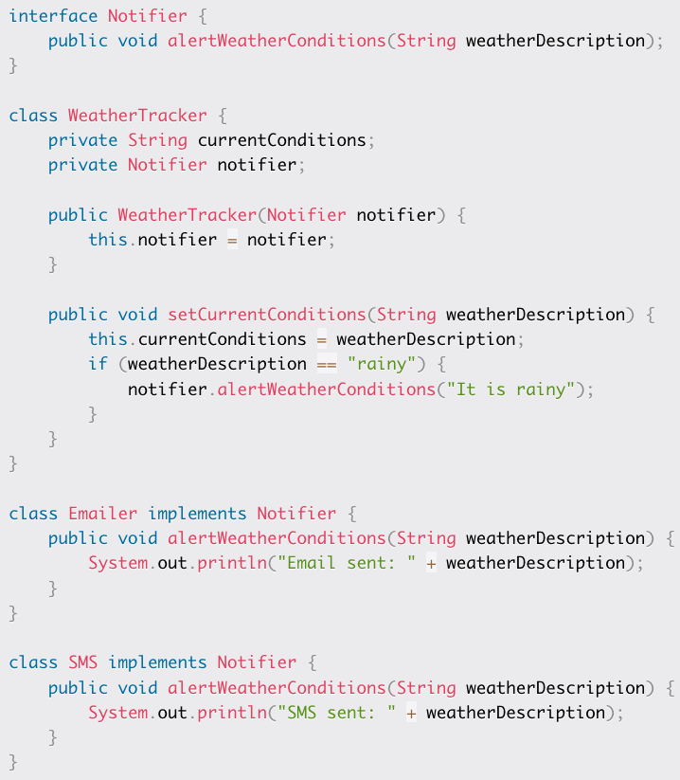
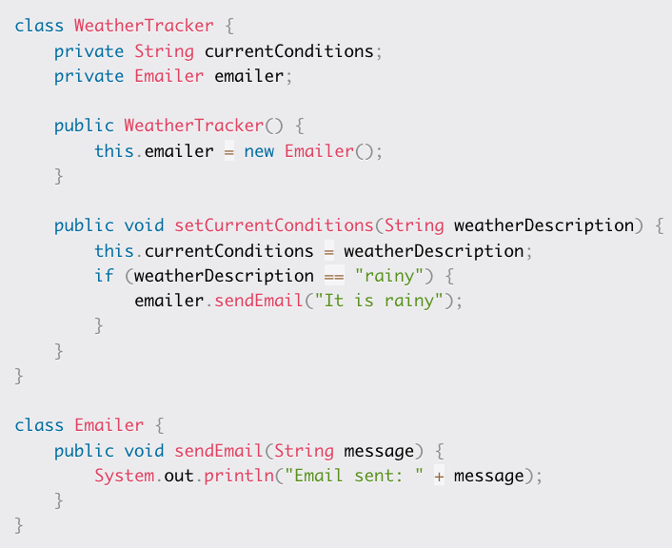
Dependency Inversion Principle (DIP)
Notes:
weatherTracker instantiates email itself. What happens when we need to change the notification? We need to reopen this, violating OCP also. DIP says weather (high level) should not depend on email (lower) but that they should both depend on an abstraction
So.. Now we have the notifier interface (abstraction) that the tracker depends on (pass in notifier and not email) and email now implements notifier. This means we can create an SMS that implements a notifier (“Abstractions should not depend on details – details should depend on abstractions”)
This makes it easy to grow and it allows us to test tracker independently( by passing in stubbed notifier).

Slide 25

Design Patterns
Notes:
So let’s get into the different patterns.

Slide 26
Types of Design Patterns
Creational design patterns deal with object creation mechanisms
Structural design patterns deal with organising objects to form larger structures and provide new functionality
Behavioural design patterns deal with recognising and realising common communication patterns between objects
Concurrency design patterns deal with multi-threaded programs

Slide 27
Creational Patterns
Deal with object creation mechanisms
With typical object creation (e.g. new Object):
Client must know which class is being created (no polymorphism)
Client must have complete control over the object creation (tight coupling)
With creational design patterns:
Object creation can be abstracted
Client may not need to know which class to create (polymorphism)
Client may not need to know how to create an object (single responsibility) New classes can be added without changing client (open-closed)
Shifts emphasis away from pure inheritance to composition and interfaces (can facilitate dependency inversion)

Slide 28
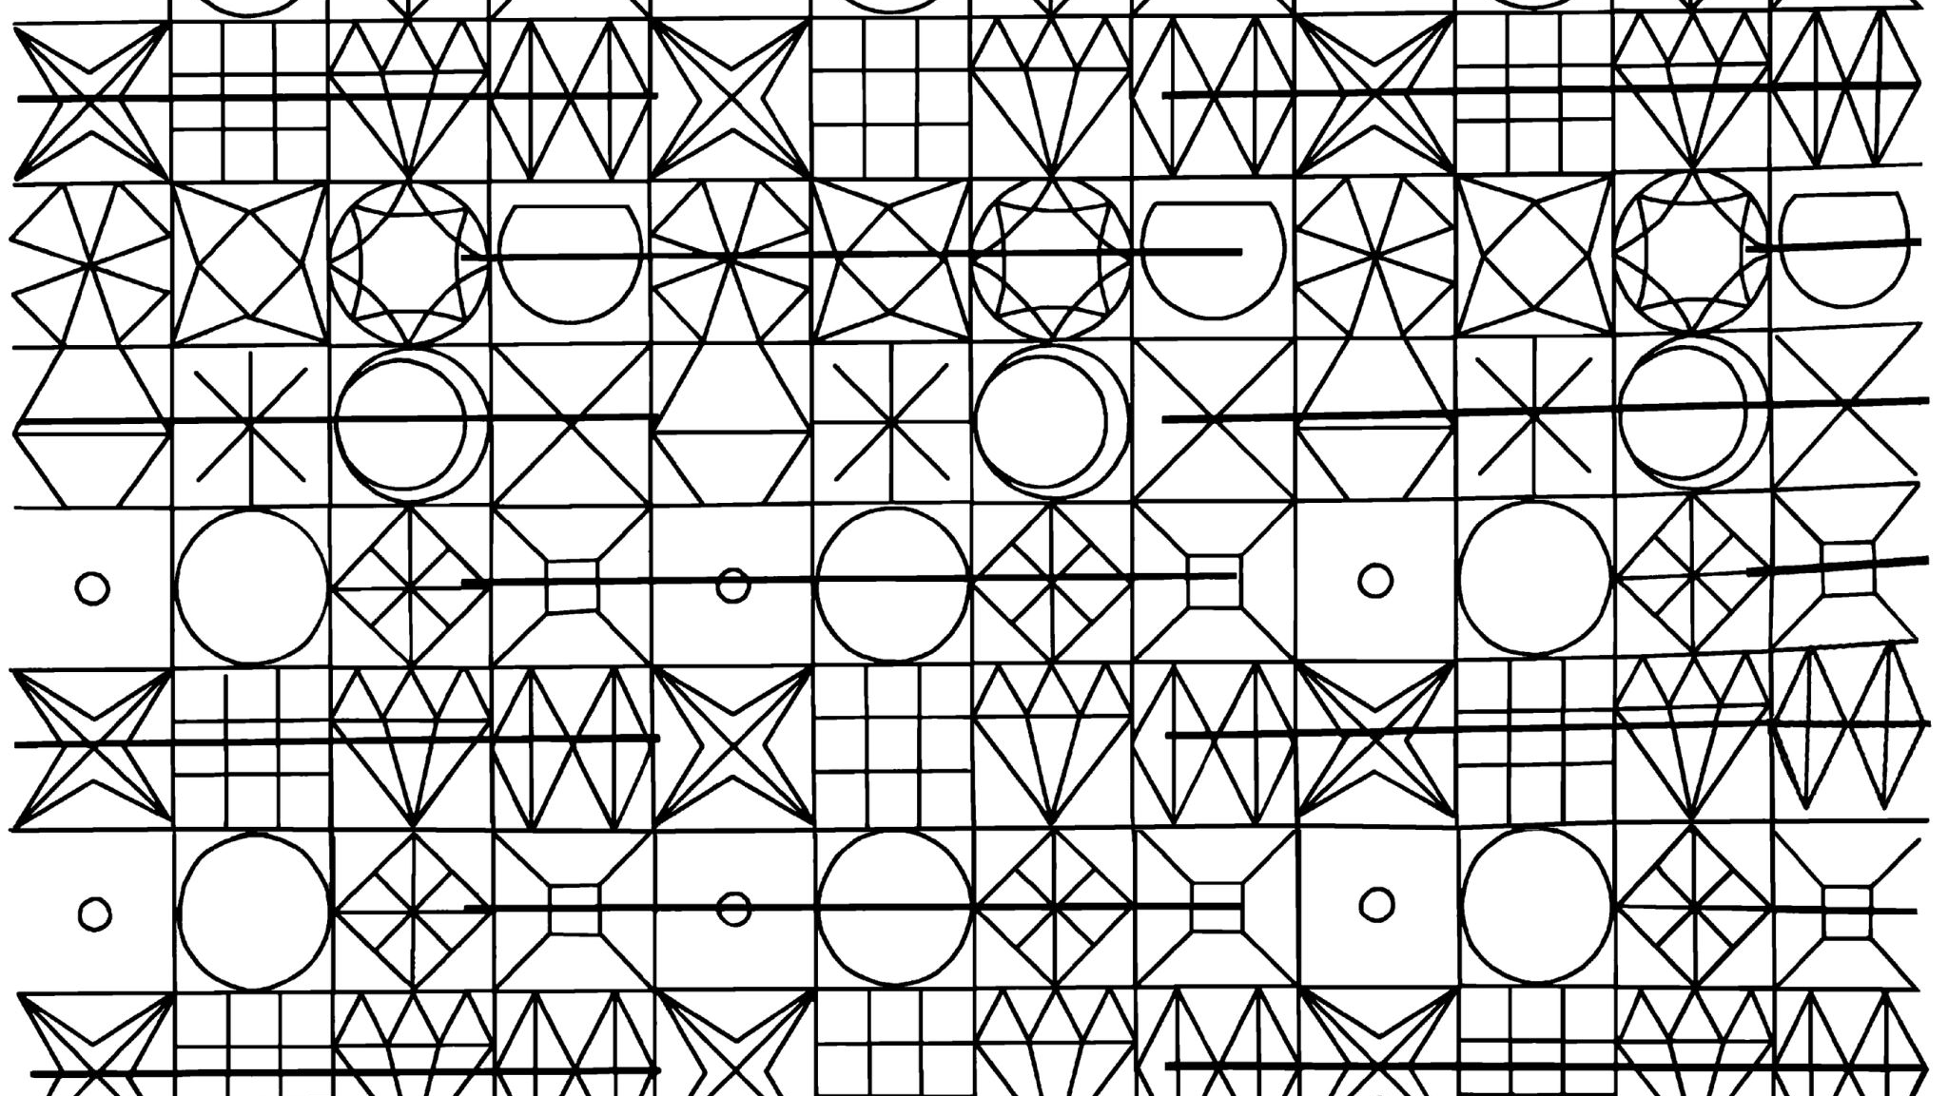
Prototype Pattern

Slide 29

Consider this
Student applies for bursary*
Company requires Fees statement, Matric results, ID Document*
Approach A
A1) Ask Wits to generate a Fees Statement
A2) Approach Umalusi to generate a matric certificate
A3) Queue at home affairs to get a new ID
Submit all artefacts to company
Approach B
Get latest fee statement sent by Wits
Create a copy of matric cert & ID
Submit copies to company

Slide 30
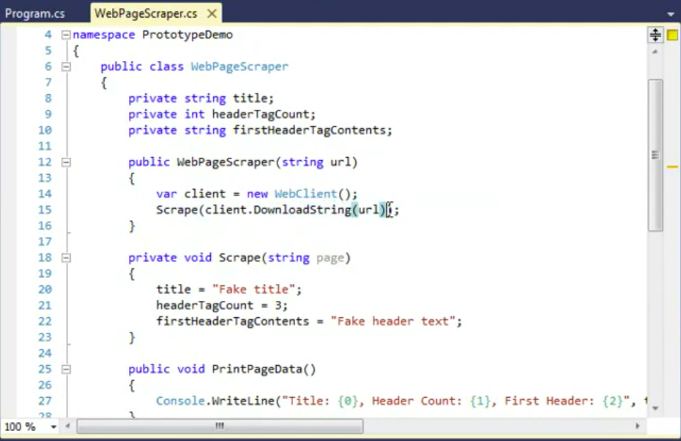
Situation
Notes:
What do you do when you need to data again to compare

Slide 31
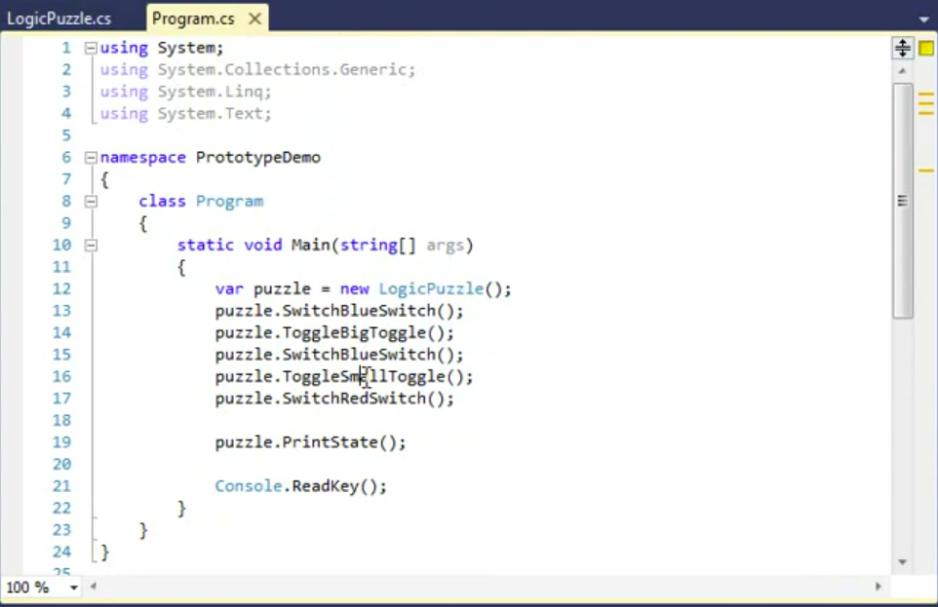
Situation 2
Notes:
In these situations, we’d want to create clones or copies. Making the OG a prototype from which others are made.

Slide 32
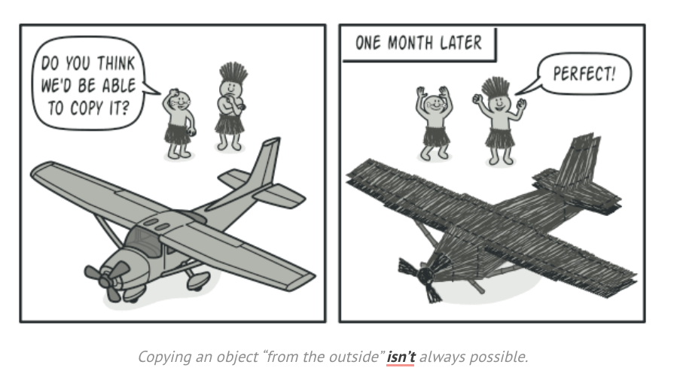
Notes:
Say you have an object, and you want to create an exact copy of it. How would you do it? First, you have to create a new object of the same class. Then you have to go through all the fields of the original object and copy their values over to the new object.

Slide 33
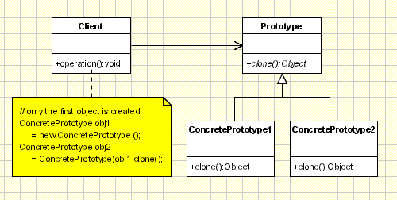
Prototype Pattern
The prototype pattern creates instances of an object by cloning a prototypical instance
Cloning existing objects is often computationally cheaper than creating new ones
Cloning an object copies its encapsulated attributes as well, which may not be known by the client
Notes:
But we’ve got some terms.

Slide 34
Prototype Pattern
Prototype: defines the interface of cloned objects
ConcretePrototype – implements the Prototype class
Client – creates one instance of the ConcretePrototype, then clones it to make any more
Notes:
So the Prototype is the interface or abstract class that defines a method to clone an object.
Concrete Prototype : any class implementing the prototype (has a waty to copy itself) – can be deep or shallow copy

Slide 35
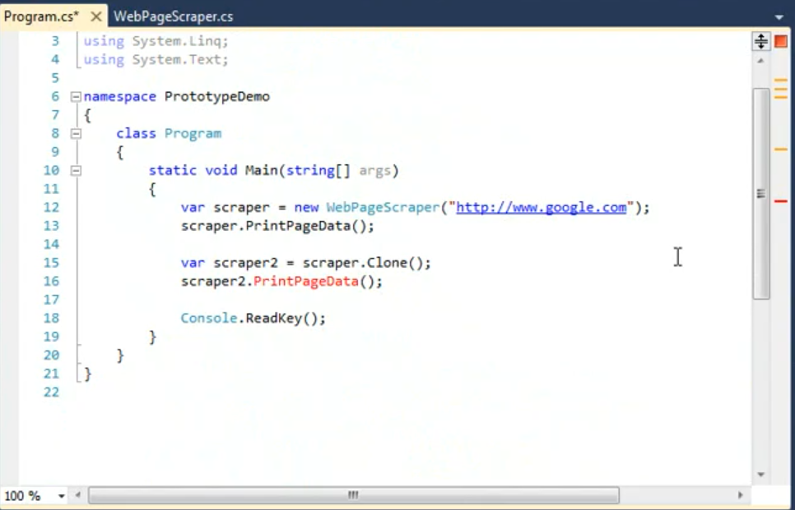
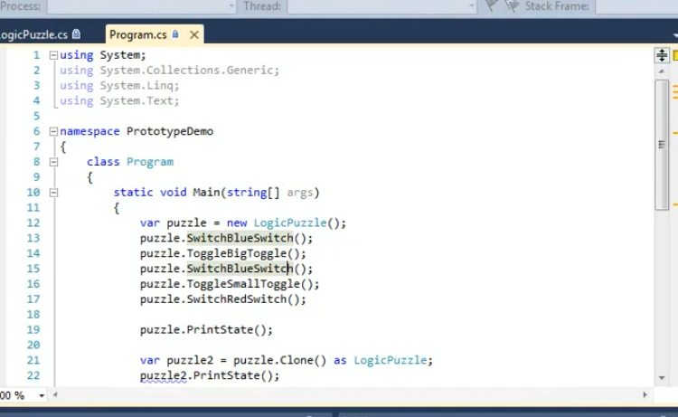
Prototype
Notes:
JS is prototypical in nature. C# has ICloneable & MemberwiseClone
Java gas Clobale & clone

Slide 36
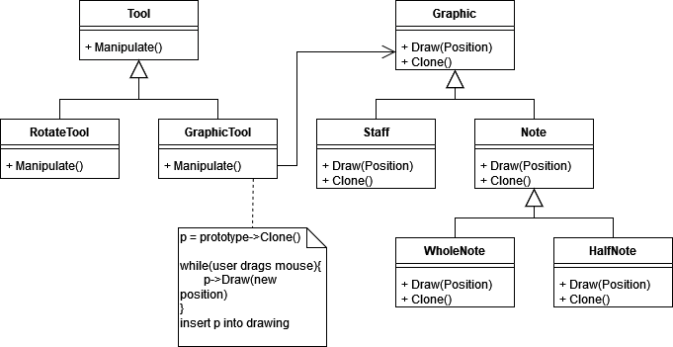

Prototype
●
Example: musical notation software

Slide 37
Prototype
Use prototype when:
a system should be independent of how its products are created, composed, and represented
a class to be instantiated is selected at run-time (e.g. dynamic loading)
instances of a class can have one of only a few different combinations of state. It may be more convenient to install a corresponding number of prototypes and clone them rather than instantiating the class manually, each time with the appropriate state

Slide 38
Prototype
●
Pros:
You can clone objects without coupling to their concrete classes
You can get rid of repeated initialization code in favor of cloning pre-built prototypes
You can produce complex objects more conveniently
You get an alternative to inheritance when dealing with configuration presets for complex objects
●
●
●
●
●
Cons:
●
Cloning complex objects that have circular references might be very tricky

Slide 39

Factory Pattern

Slide 40
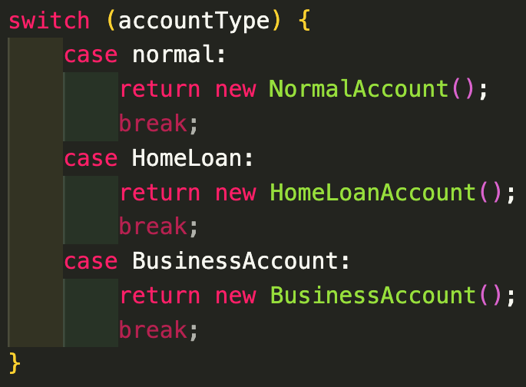
Let’s say we build a bank
Account creation needs:
Full names
ID number
Employment Details
Proof of residence
Home Loan Account
Full names
ID number
Employment Details
Property Details
Business Account
Full names * 2
ID number * 2
Company Registration Details
Proof of Business Address
var account = new Account()
var account = new HomeAccount()
var account = new BusAccount()
Notes:
Let’s say we’re writing software to open a new bank account. Each account has different requirements. We are a professionals bank like investech so we need age, occupation etc.
Problems here include the fact that there's tight coupling of client (the part of the code creating accounts) and the low-level implentation of different acc creations. ie: To add a new account type, we need to update the client and implement specific rules here.
What if we could move that responsibility away from the client and let the client just call createAccount.

Slide 41
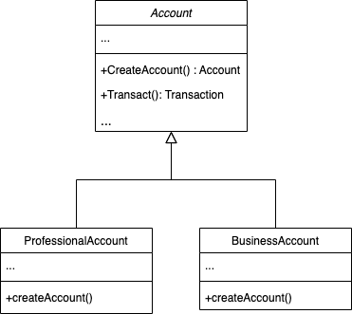
Factory Pattern
The Factory pattern AKA virtual constructor pattern suggests that you replace direct object construction calls (using the new operator) with calls to a special factory method. The objects are still created via the new operator, but it’s being called from within the factory method. Objects returned by a factory method are often referred to as products.
Notes:
What if we could move that responsibility away from the client and let the client just call createAccount.
Why is this even useful? Let’s look at a different example. Let’s take cars We need to build code that gets a car and does something with it. We don’t know what that car because there’s a new model each time. We could load those carTypes dyanmicall and at run time, control the car with the factory pattern. And this is how

Slide 42
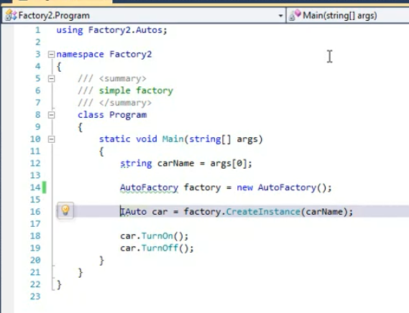
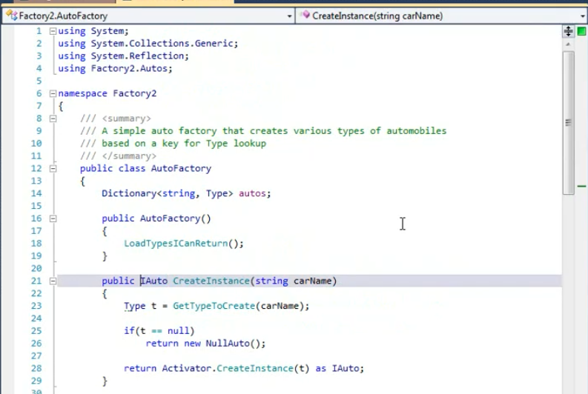
Factory
Notes:
carName is passed from console. We’ve delegated creation of that car.
Factory Method here is createInstance – returns the common interface that the concrete product needs to implement.

Slide 43
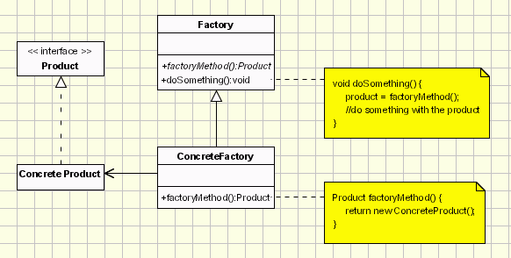
Factory
Product – defines the interface of objects created by the factory
ConcreteProduct – implements the Product interface
Factory – declares a factory method that returns a Product. May have other methods that use the factory method
ConcreteFactory – overrides the factory method to return a ConcreteProduct
●
●
●
●
Notes:
The Product declares the interface, which is common to all objects that can be produced by the creator and its subclasses
Concrete Products are different implementations of the product interface.
The Factory class declares the factory method that returns new product objects. It’s important that the return type of this method matches the product interface.

Slide 44
Factory
●
Use factory when:
a class can’t anticipate the class of objects it must create
a class wants its subclasses to specify the objects it creates you want to localise knowledge about object creation
●
●
●
●
Pros:
●
Modular expandability – can create new concrete factories and products without breaking client functionality (open-closed principle)
Delegates object creation responsibilities to a separate class (single responsibility principle)
Straightforward to test
●
●
●
Cons:
●
Requires more classes than just using a straightforward constructor call

Slide 45
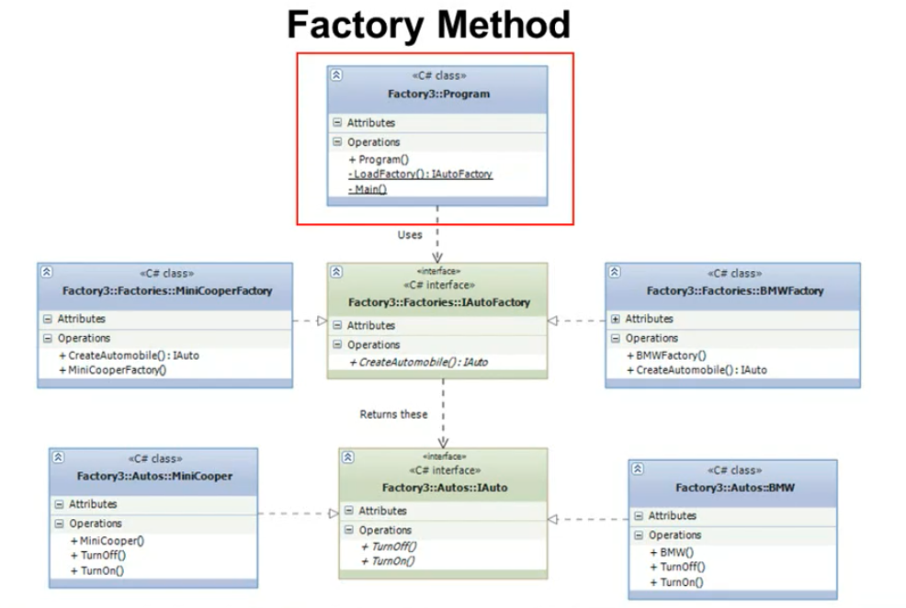
Factory Method Pattern
Notes:
An extension of the simple factory pattern, this one allows for one more abstraction – such that each subclass has a factory of it’s own. So in simple,the mainclass would tell factory to create a car, factory would need to know how each of the cars are created but with this, it instantiates specific factors that look after the finer details, all returning the same product interface though

Slide 46
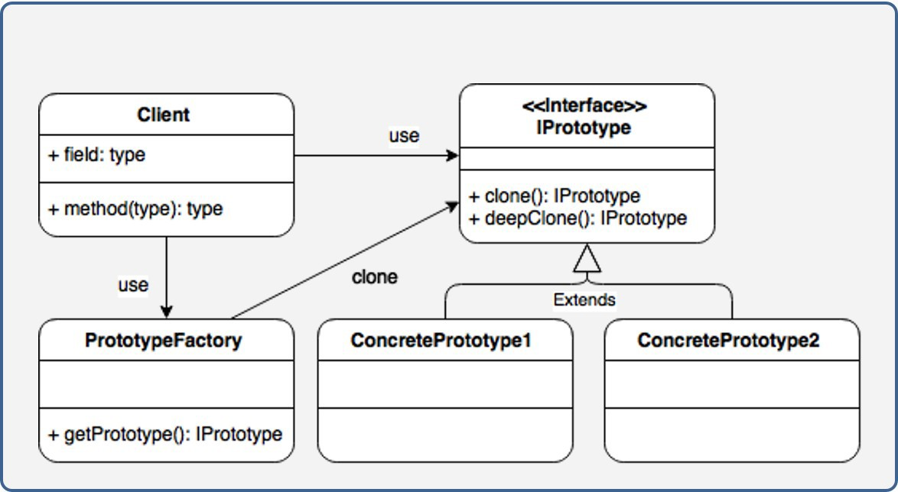
Combo: Prototype Factory

Slide 47
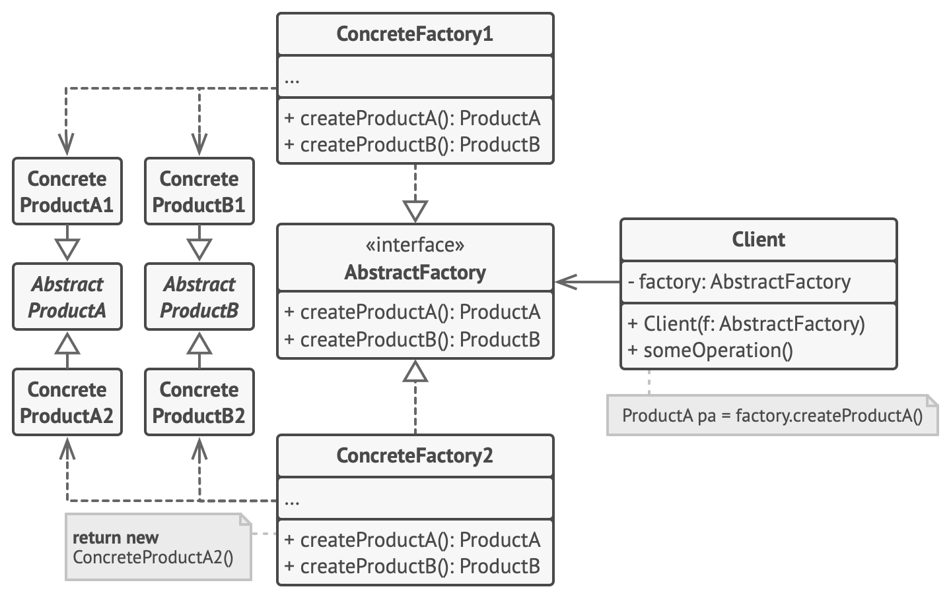
Abstract Factory
●
The abstract factory pattern, also known as the kit pattern, provides an interface for creating families of related or dependent objects without specifying their concrete classes
Note: factories can be implemented using factory methods or prototypes (i.e. cloning)
●

Slide 48
Abstract Factory
●
AbstractProduct – interface for products
ConcreteProduct – implements AbstractProduct
AbstractFactory – declares an interface for factories that create AbstractProducts
ConcreteFactory – implements AbstractFactory, creates ConcreteProducts
Client – uses interfaces provided by AbstractFactory and AbstractProduct
●
●
●
●

Slide 49
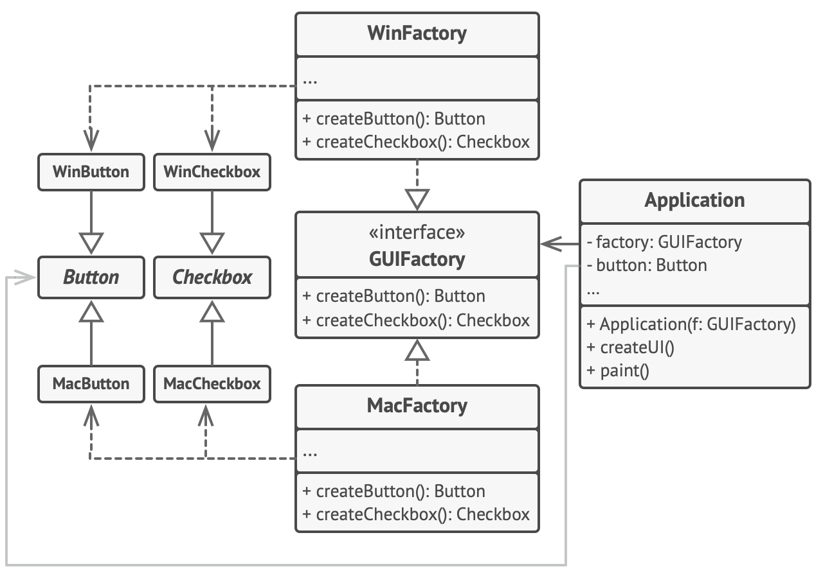
Abstract Factory
●
Example: a UI toolkit for different operating systems

Slide 50

Abstract Factory
Use abstract factory when:
a system should be independent of how its products are created, composed, and represented
a system should be configured with one of multiple families of products
a family of related product objects is designed to be used together, and you need to enforce this constraint
you want to provide a class library of products, and you want to reveal just their interfaces, not their implementations

Slide 51
Abstract Factory
●
Pros:
●
You can be sure that the products you’re getting from a factory are compatible with each other
You avoid tight coupling between concrete products and client code
You can extract the product creation code into one place, making the code easier to support
●
●
●
Single Responsibility Principle
●
You can introduce new variants of products without breaking existing client code
●
Open-Closed Principle
●
Cons:
●
The code may become more complicated than it should be, since a lot of new interfaces and classes are introduced along with the pattern

Slide 52

Builder Pattern

Slide 53
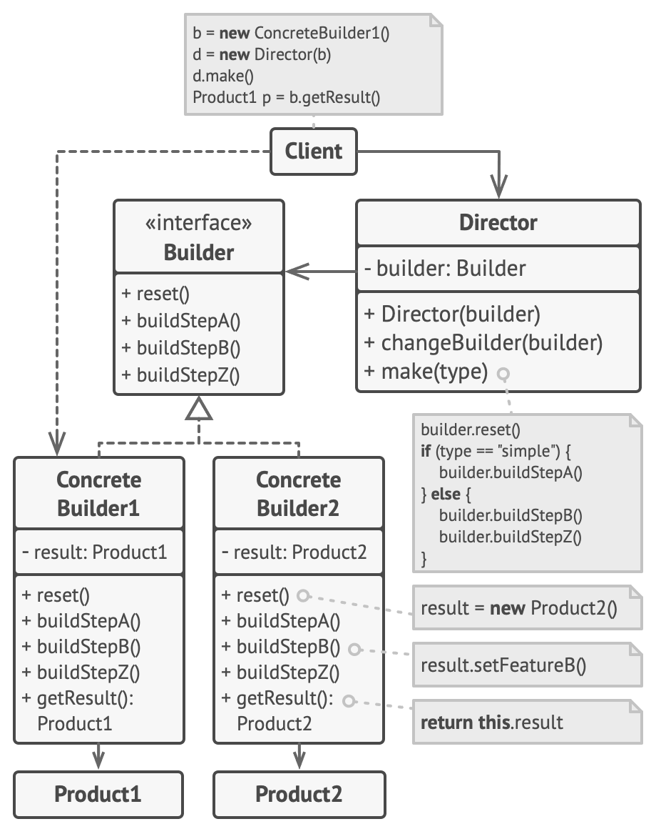
Builder
The builder pattern separates the construction of a complex object from its representation

Slide 54
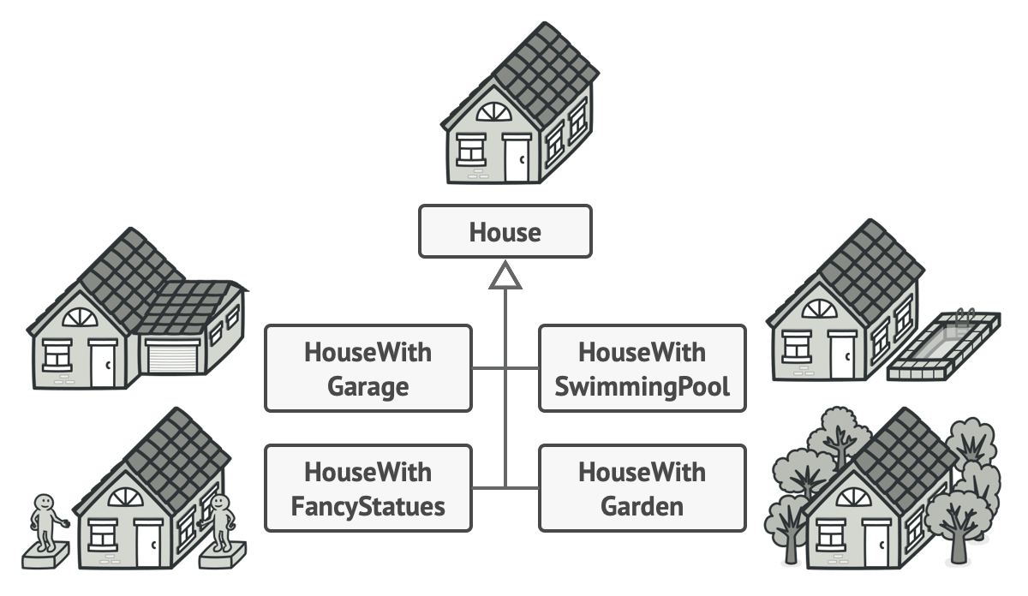
Builder
●
Motivation: Consider building a house – houses can have multiple configurations
●
We could represent these configurations using subclasses
●
Number of subclasses spiral out of control

Slide 55
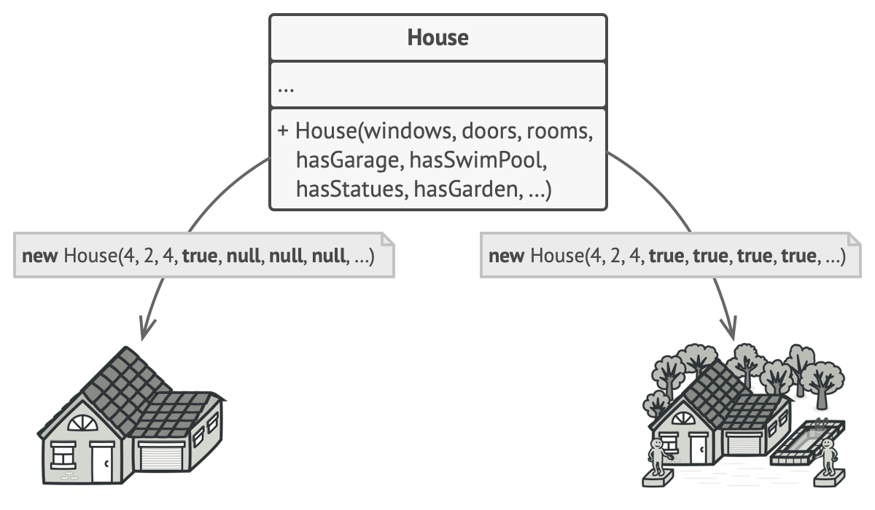
Builder
●
Motivation:
●
We could represent these configurations as attributes passed to constructor
●
Object creation becomes very very messy

Slide 56
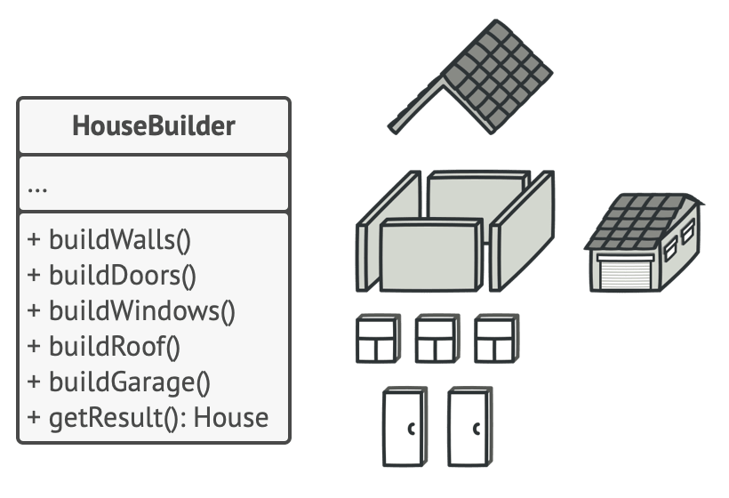
Builder
●
Motivation:
●
We instead break up object construction into steps and delegate the responsibility of executing these steps to a builder class

Slide 57
Builder
Product – the complex object to be built Builder – the interface for building Products
ConcreteBuilder – implements Builder to construct parts of Product
Director – optional class that coordinates the Builder
●
●
●
●

Slide 58
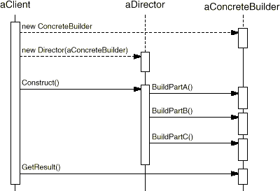
Builder
●
Building sequence

Slide 59
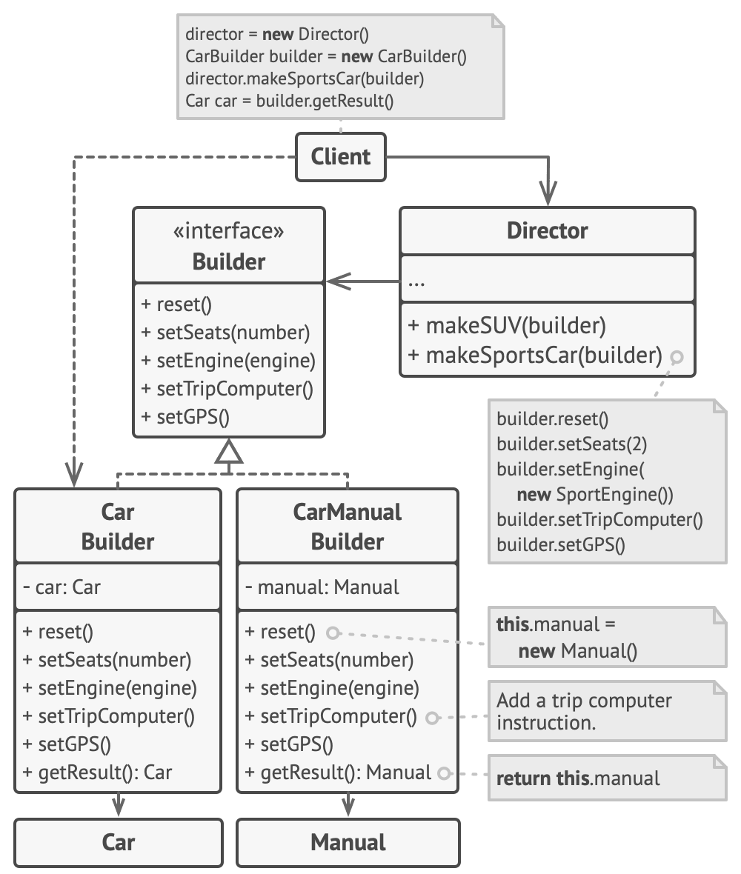
Builder
●
Example: building cars and car manuals

Slide 60
Builder
●
Use builder when:
●
the algorithm for creating a complex object should be independent of the parts that make up the object and how they're assembled
the construction process must allow different representations for the object that's constructed
●
●
e.g. stone house vs wooden house

Slide 61
Builder
●
Pros:
●
You can construct objects step-by-step, defer construction steps or run steps recursively
You can reuse the same construction code when building various representations of products
You can isolate complex construction code from the business logic of the product
●
●
●
Single Responsibility Principle
●
Cons:
●
The overall complexity of the code increases since the pattern requires creating multiple new classes

Slide 62
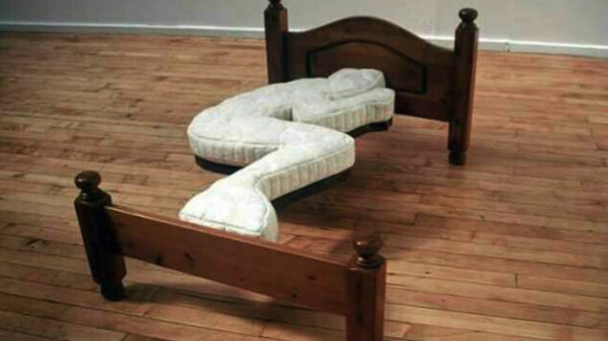
Singleton Pattern

Slide 63
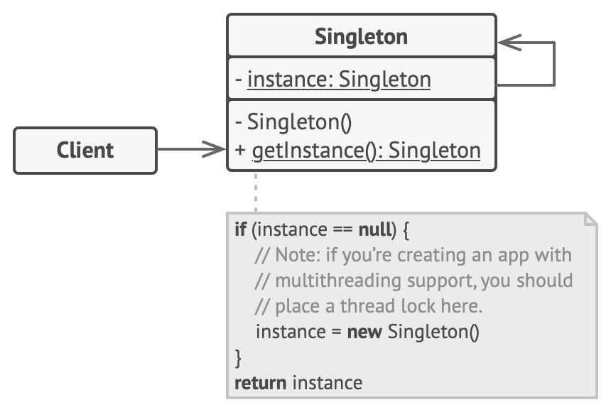
Singleton
●
The singleton pattern restricts the instantiation of a class to a single instance
It’s often useful to have only one instance of a class. Singletons let us ensure that a class isn’t needlessly instantiated more than once.
Often considered an anti-pattern
●
●

Slide 64
Singleton
●
Implementation:
Default constructor is made private
Instead, use a static creation method that calls the default constructor the first time and returns the instance on every subsequent call
●
●

Slide 65
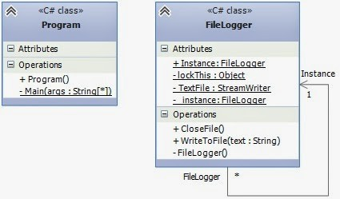
Singleton
●
Example: file logger

Slide 66
Singleton
●
Singletons vs Global Variables
Both singletons and global variables are globally accessible However, singletons can encapsulate and hide information that global variables can’t
Global variables can clutter a namespace with unnecessary variables Singletons allow for lazy allocation (only allocate memory when needed), whereas global variables always consume resources
Singletons can be subclassed
●
●
●
●
●

Slide 67

Singleton
Use singleton when:
there must be exactly one instance of a class, and it must be accessible to clients from a well-known access point

Slide 68
Singleton
●
Pros:
You can be sure that a class has only a single instance You gain a global access point to that instance
The singleton object is initialized only when it’s requested for the first time
●
●
●
●
Cons:
●
The Singleton pattern can mask bad design, for instance, when the components of the program know too much about each other
In general, globally accessible components (global variables, singletons, etc.) can result in tighter coupling
Hard to execute correctly in multi-threaded environments Hard to create mock singletons when testing
Isn’t future proof – what if we decide we need more than one?
Violates single responsibility principle – singleton does whatever it’s supposed to do, but also
●
●
●
●
●
ensures there is only one of it

Slide 69
Other Creational Patterns
●
Not in the original GoF list:
Dependency Injection – object receives objects which it depends on Lazy Initialisation – object creation is delayed until the object is actually needed in order to reduce initial load
Multition – generalises the singleton to multiple instances
Object Pool – rather than creating and destroying objects, recycle them from a pool
●
●
●
●

Slide 70
Design Pattern Pitfalls
●
Don’t design for patterns!
Trade-off between getting a product out quickly and optimising that product Optimisation is secondary
Initial designs should be refactored to patterns
●
●
●
e.g. Designs often start out using factories (as they are simple to use and easily customisable) and evolve towards abstract factories, prototypes or builders as designs are refined and optimised
Uncritical use of design patterns can turn them into anti-patterns
The need for some design patterns can be eliminated through language features
●
●
●
●
Different languages and paradigms will change how you approach design patterns

